Slide 1


The Geospatial Leadership Certificate (GLC)
Course Prospectus
© ConsultingWhere Ltd 2026. All Rights Reserved

Slide 2
Why are leadership skills so important?
The geospatial industry is creating many new and exciting solutions to address today’s global problems, such as climate change.
However, there is intense competition for the resources and the funding needed to deliver these solutions. At the same time, the geospatial industry is poorly served with the leadership skills needed to define, promote and develop new solutions.
There is a well-recognised gap in the availability of soft skills training which would enable middle managers, in both the developed world and the global south, to play leadership roles in promoting new solutions.

Slide 3
What does the Certificate offer?
Provides comprehensive training in soft skills for middle managers in both the developed world and global south
01
Make training easy to access through self-paced learning and timetabled to fit alongside existing work commitments
02
Complements online learning with access to global experts through interactive workshops and podcasts
03
Training materials based on geospatial industry expertise developed from years of real-world practical experience
04
Developing professional skills for the benefit of individuals, employers and the entire geospatial community
05

Slide 4
The learning objectives
On successful completion of the Global Leadership Certificate students will be able to:
Take a leadership role in promoting and delivering new initiatives
Understand how to develop a business case for financial investment
Successfully influence key decision makers and gain approval for new initiatives and projects
Work constructively with other departments and business partners
Position themselves to play a more impactful role in their organisations
Develop a geospatial team to deliver products and services to a wide range of stakeholders

Slide 5
Focusing throughout on Geospatial Case Studies and Experience
The course is specifically designed for geospatial practitioners:
All modules are led by geospatial experts with many years experience delivering in this industry
Insight podcasts include interviews with geospatial influencers from public and private sectors
Assignments are designed to enable students to apply learning to their current geospatial work
Workshops provide access to subject matter experts with global geospatial experience
Background reading and references include seminal papers relevant to the geospatial domain
A series of scenarios based on typical geospatial challenges are used to illustrate each module

Slide 6
GLC: Delivery Model
Modules delivered over a 9-month period
Online training (using Microsoft Teams)
  Personal tutor assigned to each student
  Regular pre-agreed one to one contact sessions
  Maximum 12 students per course
Three components to each module
  Concepts and Principles
  Assignment
  Subject Matter Expert Workshop
Content continuously refined based on student feedback
Notes:
AC
We are now recruiting our third cohort of students.

Slide 7







Core Teaching Team
Andrew Coote
Leadership, Building the Business Case for Investment
Sustainable Business Models, Impact of AI & Tutor
Harry Storer
Communicating with Decision Makers, Basic Sales
Marketing Strategy and Implementation & Tutor
David Rix
Team Development & Tutor
Dr Robin McLaren
Geospatial Project Management
Geospatial Maturity Assessment and Governance & Tutor
Dr Jeremy Morley
Research Advisor & Tutor
Full details of the team can be viewed and CVs downloaded here:
Elisabeth White
Education Advisor
E-Learning Developer
Sonya Tolmie
Finance
Administration

Slide 8
The value of the Geospatial Leadership Certificate is multi-faceted
Provides an opportunity for employers to offer specialist training to their staff, and improve the organisations’ ability to develop, implement and market new solutions
Improves decision-support for crucial work of addressing global issues such as climate change
Enables Geospatial professionals to develop their soft skills and enhance their career prospects
Watch the Value Proposition video (2 minutes) here:
Notes:
Used as source material for Youtube advert.
https://www.youtube.com/watch?v=9snMqkdS0kU

Slide 9
Core modules
The Global Leadership Certificate aims to develop critical management skills through four core modules:
Leadership
Team Development
Making the Business case for investment in geospatial
Effectively communicating the benefits of geospatial to decision makers

Slide 10
Optional modules
Students will then be able to choose two further modules from the following:
Geospatial Project Management
Geospatial Maturity Assessment and Governance
Sustainable Business Models
Marketing Strategy and Planning
Mastering Basic Sales Skills
The Impact of Artificial Intelligence

Slide 11
Commitment (estimated 16 hours per module)
The course is designed to be completed over a period of 9 months.
Each module comprises (effort estimates are approximate):
Completion of pre-course reading / research
( 1 hour)
Self-paced online e-learning component covering concept, principles and case studies.
(2 hours)
Participation in an online workshop, with industry experts. Content determined by students to aid refinement of assignment.
(2 hours)
Research and preparation of the draft assignment
(8 hours)
End of module review with your tutor concerning performance and identification of any further work required
( 1 hour)
Refine assignment based on workshop and feedback by tutor.
(2 hours)
11
Notes:
HS
Describe components
We will challenge you in each module to research a topic relevant to the learning objectives. You will prepare an essay and also a brief presentation, ideally to be a video recorded on your phone, summarising the key points.
You will participate in an online webinar with other students and industry experts where:
We will review your presentations and provide constructive feedback
Provide an opportunity to ask questions
Response to views and opinions of fellow delegates
Once you have completed the module there will be a final interview with your tutor to discuss your performance and any follow up work required
Per module total effort required is estimated at 16 hours (2 days) – we assess this as reasonable level of effort to be accomplished alongside normal working commitments.
NB Each assignment will be set by the tutor but defined in a manner to enable student to set their assignment in the context of their own organisation.

Slide 12
Course timetable - delivered over 9-month period
Week 1-2
Introduction
Week 3-8
Leadership
Week 9-14
Team Development
Week 15-20
Investment
Business Case
Week 21-26
Communicating with Decision Makers
Week 27-30
Mid Course Break *
Week 31-36
Optional Module 1
Week 37-42
Optional Module 2
Week 44
Course Completion
Certificate Award
* Mid course break timed to suit Easter, Summer or Christmas holiday periods

Slide 13

Module Content:
Core modules
Summary

Slide 14
Module 1: Leadership
What is meant by leadership?
Styles, their applicability to different situations and relationship to personal strengths and ambitions
Strategies to help you realise your leadership potential
Emotional intelligence
What is it and why is it important in the context of leadership
Personality types
Why understanding them is key to relationship building (using the DISC Model)
Strategies for dealing with conflict
Putting what you have learnt into practice

Slide 15
Module 2: Team Development
Fundamentals
It’s all about people
Defining roles
Beyond the job description
Team profiling
Useful methodologies to developing balanced teams
Practical experience
Sharing insights from the experts
Team building techniques
  Aligning around goals
  Minimising ambiguity
  Developing inter-personal skills
  Problem solving
  Defusing tensions
Common challenges
  Virtual working
  External constraints
  Workplace politics
Next steps
  Links to other modules
  Further learning

Slide 16
Module 3: Building the Business Case for Investment
What is a business case and why is it needed?
Economic principles
The Nature of Value
Demand and Supply
Methodologies
Multi-criteria approaches
Cost-benefit analysis
Computable general equilibrium modelling
Quantifiable use cases
Principles and selection
Assembling primary evidence
Benefits Transfer
Qualitative use cases
Adding political, social and environmental benefits
Assembling the economic model
Applying risk assessment
Benefits realisation

Slide 17
Module 4:
Effective Communication with Decision Makers
Storytelling
  Structure
  The elevator pitch concept
  Insights from the experts
Principles
Developing a communications strategy
Using the right language
Creating a simple to follow link between cause and effect
Knowing your audience
  Research their careers – likes, red flags, interests outside work
  Reading the room – who are the decision makers, influencers and blockers
  Responding to “push back”
Delivery
  Establish credibility
  Keep it short
  Leave time for discussion
Assess and refine the message

Slide 18

Module Content:
Optional modules summary

Slide 19
Module 5: Geospatial Project Management
What is special about managing a geospatial development project?
Key differences to non-spatial projects that influence their management
Estimating and planning
Pitfalls and good practice
Scope control
Managing change
Project governance, monitoring and control
Who needs to be involved
Roles and responsibilities
Critical success factors
Technical and business
Identifying and managing risks

Slide 20
Module 6: Marketing Strategy and Implementation
The marketing playbook
Researching markets
Competition / selling strategies
Testing the value proposition
Evaluate market engagement approach
  Direct
  Channel
  Partnership
Defining the market programme
  Estimating profit and loss over time
Implementation
  Social media advertising strategies
  Continued role of face-to-face interaction
Monitoring customer acquisition and retention costs
Customer Relationship Management (CRM) and other tools

Slide 21
Module 7: Geospatial Maturity Assessment and Governance
What is a Geospatial Maturity and Why is it needed?
  Why a full understanding of the current state is essential to planning the future
Establishing a Framework for Assessment
Evaluating different perspectives (based on UN IGIF and URISA models)
What are the key criteria and how can be objectively assess them?
Identifying and Engaging Stakeholders
Who to engage
How to determine influence and interest
Validating Input and Analysis
Delphi approach to normalising results
Identifying and accounting for bias
Presenting and Deploying Results
Establishing effective Governance
The essential components of good governance
Successful models – good practice and sustainability

Slide 22
Module 8: Sustainable Business Models
Concepts and definitions
  What is a business model and why is it important?
  Discussion of sustainability – in climate change and finance contexts
Understanding your current organisational business model
  Introducing the Business Model Canvas
Evolution of business models
  Traditional and innovative business models
  Their application to modern technology and specifically geospatial organisations
Funding options – sources of finance
  Private sector and public sector approaches
How to unlock finance – developing an action plan
Case studies
  Recent examples of successful evolution of business models

Slide 23
Module 9: Basic Sales Techniques
We are all in sales
Principles of consultative selling
7 Pillars of persuasion (Cialdini)
The sales filter – validating opportunities
What makes a good sales professional?
  Character traits
  Life experience
  Resilience
Sales stories
  The good, the bad and the ugly
  What we can learn from these real-world examples
What next?

Slide 24
Module 10:
The Impact of Artificial Intelligence (AI) for Geospatial
Concepts and Definitions
  What is Artificial Intelligence (Myth and Reality)
  Large Language Models, Agentic AI, Computer Vision
Geospatial Impacts
  Geospatial AI (Feature Extraction, Predictive Analysis)
  AI Assistants
AI for Earth Observation (AI4EO)
  Foundation Models for Earth Observation
  Applications for Environmental Monitoring and Biodiversity
Transforming Business
  Vibe Coding
  Technical Support
  Consulting
Challenges
  Can AI understand geography?
  Transparency, Trust, Sovereignty and Sustainability

Slide 25
Certificate award
It is recognised that students studying for the certificate are likely to be at different starting points and have different aspirations
There are 9 modules which will be offered in each instance
Each module will count equally (25 credits each) - to receive the certificate students will only be required to take and pass 6 modules - collecting 150 credits
Passing each module will be based on completing the e-learning component, completion of the research and assimilation component, participation in the final workshop and the final assessment

Slide 26
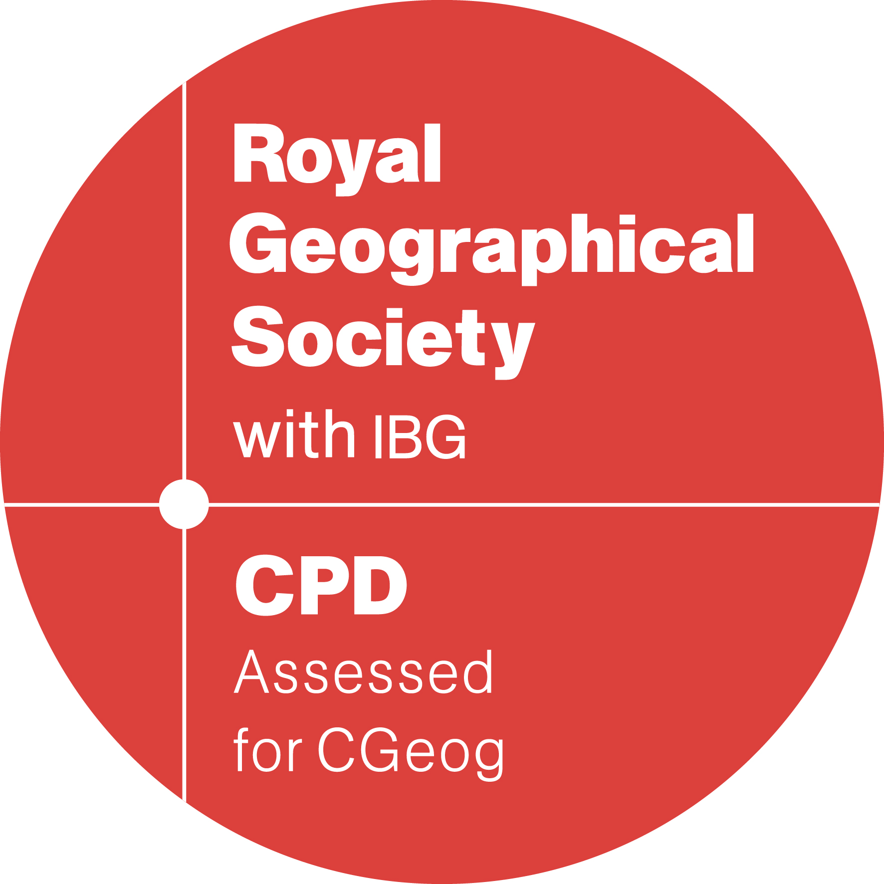


Accreditation
Royal Geographical Society with IBG
Attendees may record CPD hours for activities undertaken on the course modules to a maximum of 5 hours / points per day and up to 16 hours / points for each module
Association for Geographic Information (AGI)
Each core module has been allocated 10 CPD points
Royal Institution of Chartered Surveyors (RICS)
Course supervised by Chartered Surveyors and may be submitted as part of members CPD record

Slide 27
Frequently asked questions
Q. Is the certificate accredited?
A. Yes, the course is accredited as part of their Continued Professional Development (CPD) schemes with the main geospatial professional bodies in the UK the RICS, RGS and AGI. We are also working internationally to integrate the course into professional curricula in Europe and Australasia.
Q. How has the course material been developed?
A. ConsultingWhere have recruited internationally-recognised geospatial experts with many years practical experience in implementation for each module. We have also recruited an advisory panel to ensure the material reflects current academic thinking and industry needs.
Q. Is it possible to undertake individual modules from the course?
A. Yes, we will accept applications to take single modules, if there is space available but preference will be given to students studying for certification.
Q. What are the entry qualifications for the course?
A. There are many suitable routes to entry and no set academic qualifications required. However, students are expected to be currently employed in a management position or have experience of such a role. Even if your profile doesn’t match these guidelines, please don’t be discouraged from discussing your needs with us.

Slide 28

GLC: How to find out more
Go to the Website
https://consultingwhere.com/the-geospatial-leadership-certificate-glc/
Course administrator email: info@consultingwhere.com
Phone
+44 1923 291000
WhatsApp
+44 7860884119
Scan the QR Code
An accessibility tested version of this document in Word is available upon request.

